Slide 1
React Component

Slide 2
Objectives
What is React component?
Use JSX to define the views of your component
Class Components
Lifecycle in Class Components
Functional Components

Slide 3
React Components
A component returns a set of React elements that should appear on the screen
Components enable you to split your UI into independent, reusable pieces
Components also accept inputs
Different kinds of components can be defined in React

Slide 4
What is a Component?
Components are the building blocks of React applications.
A React component is a function or a JavaScript class that optionally accepts data and returns a React element that describes some piece of the user interface.
A React user interface is made up of a hierarchy of components that build up to a single component (called the root component) that is rendered in the web browser

Slide 5
Importance of Components
Reusability
Encapsulation
Composition
Unidirectional Data Flow
Efficiency

Slide 6

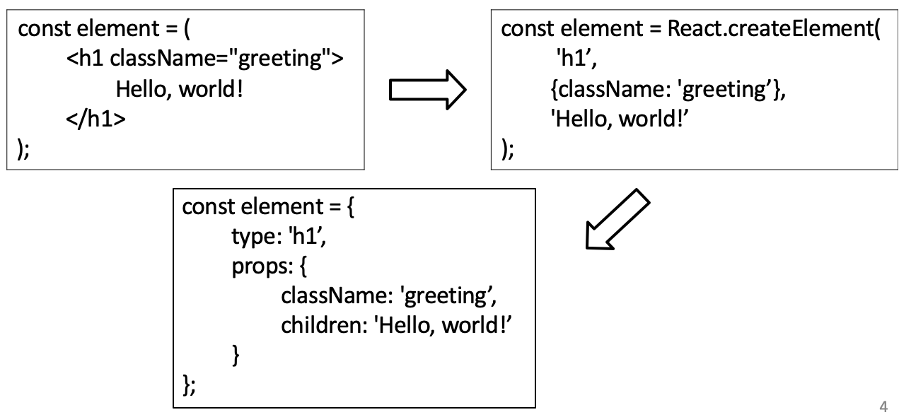
JavaScript XML (JSX)
Syntactic extension to JavaScript
Shorthand notation to represent JavaScript functions calls that evaluate to JavaScript objects
Avoids artificial separation of rendering logic from other UI logic
JSX makes it easier to write and add HTML in React.

Slide 7
Fragments of JSX
Fragments are a way to group together chunks of markup without having to add unnecessary structure to your page.
When a component renders a fragment, React knows to render the fragment's child element wherever the component is used

Slide 8
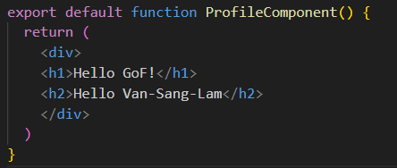
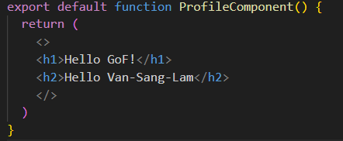
Fragments of JSX - Demo
Instead of wrapping the component content in <div>, the <> element is used. This is a special type of element that indicates that only its children need to be rendered.

Slide 9
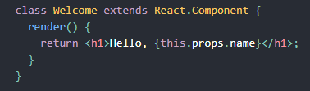
Class Components
Create class components, also known as stateful components, using JavaScript classes.
Manage state and lifecycle methods.
Use class components for scenarios requiring state or when specific events such as component creation or updates call for actions.

Slide 10
Lifecycle in Class Components
Class Component goes through the following lifecycle stages:
Mounting
Updating
Unmounting
Several lifecycle methods available in each stage:
constructor(props)
componentDidMount()
componentDidUpdate(prevProps, prevState, snapshot)
componentWillUnmount()

Slide 11
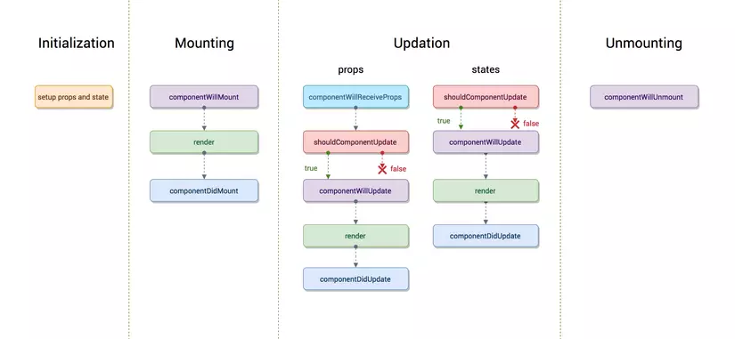
Lifecycle in Class Components (cont.)

Slide 12
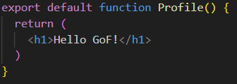
Functional Components
Hooks: It allow you to use React features such as state, lifecycle methods, and context as Class Component.
Function Component (Stateless Component)
A functional component is simply a JavaScript function with Hooks.
It returns the html code that describes the UI
doesn't need to manage state.
doesn't need lifecycle methods (although this can now be handled with the useEffect Hook).
write less code and keep things simple.

Slide 13
Effects in Function Components
The Effect Hook can be seen as a replacement for componentDidMount, componentDidUpdate, and componentWillUnmount in class components, unified into a single API.
useEffect is called after every render by default, including the initial render. It takes two arguments:
A function where you place your side effect logic.
An optional array of dependencies.

Slide 14
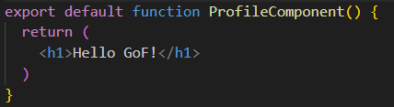
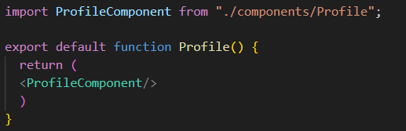
Exporting and importing a component

Slide 15
Component Conventions
User-defined component names must always start with a capital letter
These compile to React.createElement(. . .)
HeaderComponent, FooterComponent ….)
Tags starting with lowercase letters are treated as DOM tags
Built-in components

Slide 16
Higher-Order Components
A Higher-Order Component (HOC) allow reuse component logic, which can help keep your components small and focused.
They can be used to modify props, change rendering, abstract state, and wrap components for context or theme.

Slide 17
Higher-Order Components – cont’d
// Higher Order Component
function withExtraProp(WrappedComponent) {
return function EnhancedComponent(props) {
return <WrappedComponent {...props} extraProp="I am an extra prop!" />;
}
}
// Regular Component
function MyComponent(props) {
return <div>{props.extraProp}</div>;
}
// Enhanced Component with HOC
const EnhancedComponent = withExtraProp(MyComponent);
// Usage
<EnhancedComponent /> // Will render: <div>I am an extra prop!</div>

Slide 18
Component Composition
It is a natural pattern of assembling complex UIs by piecing together components like Lego blocks.
It involves building small and reusable components and combining them to create more complex user interfaces.
Benefits of Component Composition: Reusability, Separation of Concerns, Testability.

Slide 19
Component Composition – cont’d
function Header() {
return <h1>Welcome to GoF domain!</h1>;
}
function MainContent() {
return (
<div>
<Member />
<Member />
</div>
);
}
function Member() {
return <p>This is a friend.</p>
}
function Footer() {
return <h3>Thanks for visiting!</h3>;
}
function App() {
return (
<div>
<Header />
<MainContent />
<Footer />
</div>
);
}
}

Slide 20
Summary
Concepts were introduced:
What is React component?
Use JSX to define the views of your component
Class Components
Lifecycle in Class Components
Functional Components

